Slide 1
NCCS Chatbot
Kriti Ghimire
NCCS College
TU Reg: 28870

Slide 2
Table of Contents
Introduction
Problem Statement
Objectives
Diagrams
Algorithm Details
Completed Task
Remaining Task

Slide 3
Introduction
NCCS Chatbot is a web application designed in HTML,CSS & JS in frontend and Python in backend.
Is responsible to response the queries about the NCCS College.
Is a virtual assistant.
Also measures the accuracy of the result.
Streamlines information retrieval on various aspects of the college.
Helps to saves time and reduces the need for direct human interaction.

Slide 4
Problem Statement
The repetitive queries can cause the additional workload to the system.
The users can face the problem in the accuracy of the result.
Inefficient communication may arise.

Slide 5
Objectives
To provide access to college information like admissions, fees, courses and so on.
To minimize the need for in-person visits or calls.
To provide the response using LSTM algorithm.

Slide 6
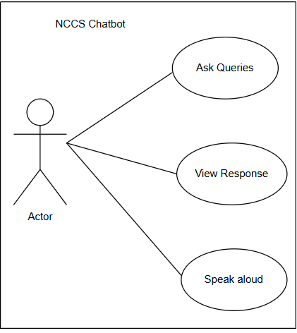
Use Case Diagram

Slide 7
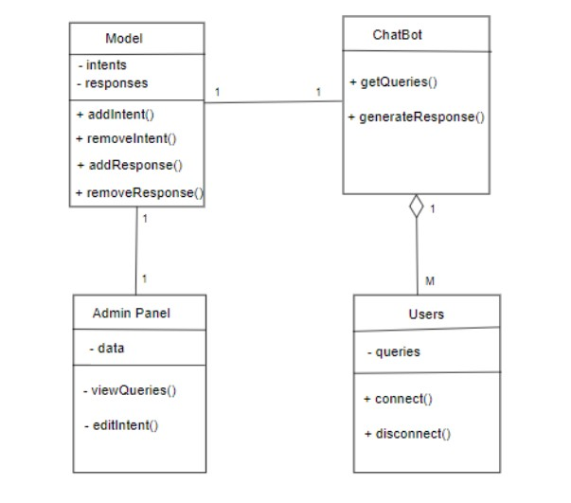
Class Diagram

Slide 8
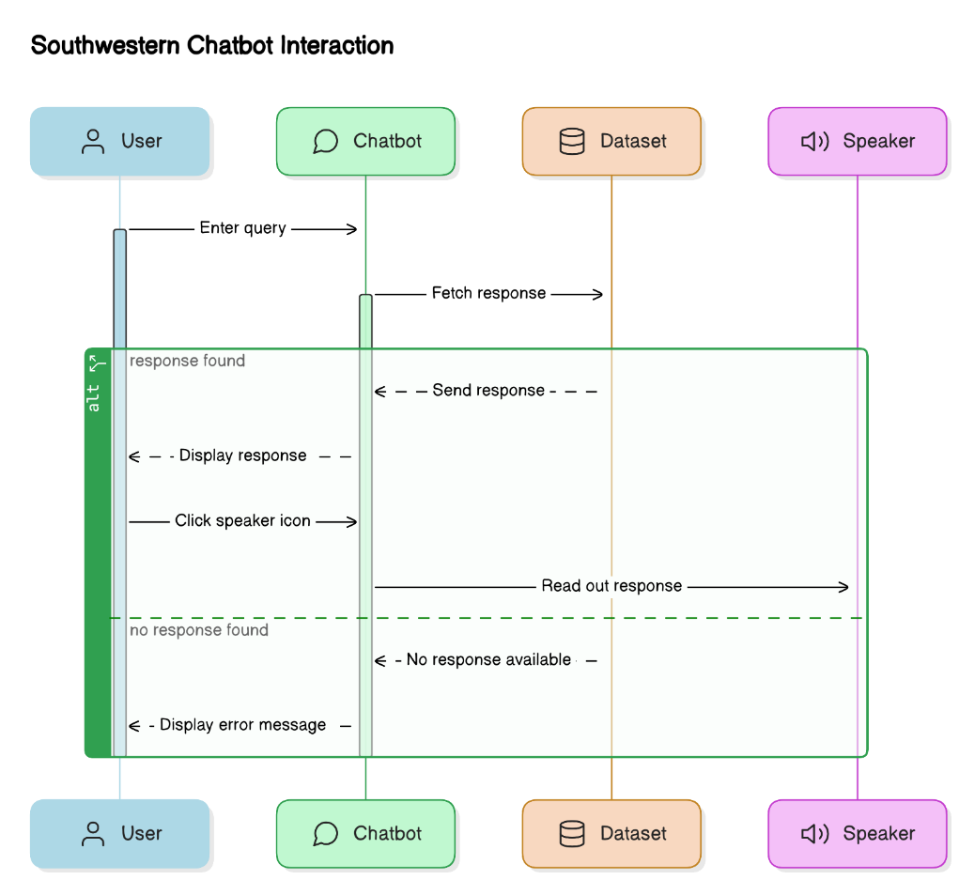
Sequence Diagram

Slide 9
Algorithm Details
Long Short-Term Memory (LSTM) is an enhanced version of the Recurrent Neural Network(RNN).
LSTMs introduce a memory cell that holds information over extended periods.
It greatly mitigate the Vanishing Gradient .
It is controlled by three gates , they are:
Input Gate
Forget Gate
Output Gate

Slide 10
LSTM Main Layers
Embedded Layer
LSTM layer
Dense Layer
Dropout Layer
Batch Normalization Layer

Slide 11
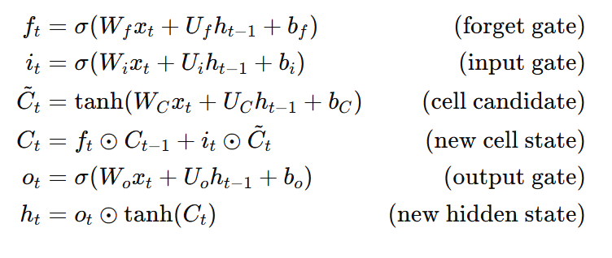
The equations for the LSTM are:

Slide 12
Completed Task
Front-End Development
Designed and implemented user interface with HTML/CSS
Algorithm Implementation
Built and trained model (Embedding, LSTM, Dense layers).
Text-to-Speech Integration
Implemented audio responses using gTTS for both models.

Slide 13
Remaining Task
Backend Development
Testing and Evaluation
Deployment

Slide 14
Conclusion
The NCCS Chatbot project is progressing effectively, with substantial completion of the frontend and core algorithmic functionalities. Completing the backend, thorough testing, and final deployment will enable delivering a robust and responsive chatbot tailored for NCCS College.

Slide 15
Thank You

